Slide 1
Olist Marketplace Logistics Intelligence
& Predictive Engine
An end-to-end data pipeline: Relational SQL modeling, operational Power BI tracking, customer and inventory behavioral analytics, and real-time ML freight price estimation.
Slide 1 of 8

Slide 2



Project Goals & Scope
Operating hurdles across the decentralized marketplace and structured technical solutions
Business Problem Statement
Sequential Technical Pipeline
Olist connects thousands of independent sellers across Brazil, but logistical friction impairs platform growth and repeat buyer trust:
Architected a structured 4-stage engineering workflow to systematically address each friction point:
▪
Delivery SLA Breaches: Severe interstate transit delays cause customer review scores to collapse.
▪
SQL Modeling: Enforce relational integrity, fix join fan-out, and disambiguate customer identities.
▪
Freight Fee Volatility: Unpredictable regional delivery fees lead to cart abandonment at checkout.
▪
Power BI Reporting: Deploy an executive dashboard suite tracking GMV, SLA breaches, and delays.
▪
Customer Churn: Marketplace functions heavily as an acquisition-dependent single-purchase channel.
▪
Python Analytics: Perform RFM segmentation, ABC/XYZ Pareto curves, and basket affinity mining.
▪
ML Deployment: Train gradient-boosted models and deploy a live Streamlit quoter.
Slide 2 of 8

Slide 3







Data Engineering & SQL Foundation
Automated Python ingestion, relational join fixes, and core analytics extracted in MySQL
Automated Ingestion & Schema
Relational Join & Identity Fixes
Core Models Extracted in SQL
Direct CSV imports failed due to memory timeouts across 100k records. Built a streaming Python pipeline with pymysql to sanitize and load all tables.
Joining multi-item orders with split installment payments caused a Cartesian fan-out error, falsely inflating reported revenues by 200–300%.
Engineered baseline metrics and operational supply chain models directly inside MySQL before passing data to Power BI:
▪
Enforced Foreign Keys across all 8 relational tables.
▪
Decoupled CTEs: Pre-aggregated line items and payment methods independently before final joins.
▪
Financials: R$ 16.01M GMV, R$ 13.59M Net Revenue, R$ 160.99 AOV.
▪
Discovered and patched missing category translations (pc_gamer and food prep appliances).
▪
Entity Disambiguation: Mapped temporary keys (cust_id) to real identities (cust_unique_id).
▪
Milestone Lags: Isolated seller dispatch delay from transit time.
▪
Advanced Analytics: ABC Pareto tiers, XYZ volatility metrics, and stored procedures for audits.
Slide 3 of 8

Slide 4
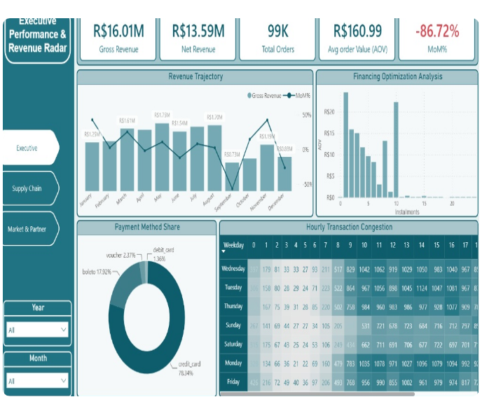







Executive Revenue Radar & Commercial Economics
Tracking financial trajectory, credit card financing multipliers, and hourly transaction velocity
R$ 16.01M
R$ 13.59M
GROSS REVENUE
NET REVENUE
99,000
R$ 160.99
TOTAL ORDERS
AVG ORDER VALUE
Payment Splits & Boleto Lag
Credit cards account for 78.34% of volume, followed by Boleto at 17.92%. Boleto introduces a 24–48 hour banking clearance delay before merchant fulfillment can begin.
Installment Multiplier & Peak Hours
Financing optimization proves extended plans (8–10 installments) more than double Average Order Value compared to single payments. Volume peaks on weekdays between 13:00 and 16:00.
Slide 4 of 8

Slide 5
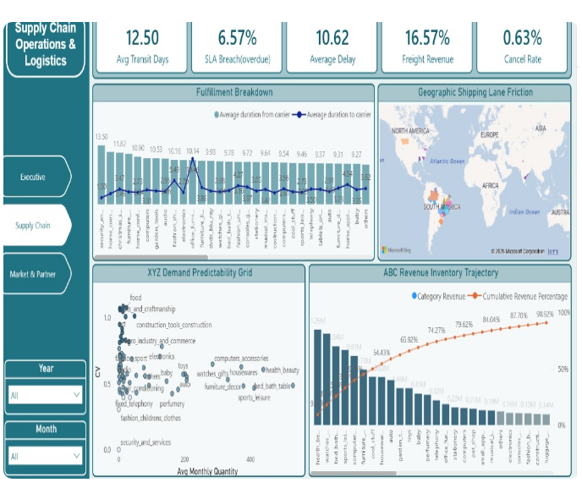
Supply Chain Operations & Fulfillment Latency
Decomposing transit duration, pinpointing SLA breaches, and classifying inventory health
12.50 d
6.57%
AVG TRANSIT DAYS
SLA BREACH RATE
10.62 d
16.57%
AVG DELAY IF LATE
FREIGHT REVENUE %
The 2.71-Day Handover Lag
Sellers consume an average of 2.71 days packaging goods before carrier custody. Delivery couriers take public blame, but preventable delivery breaches originate with merchant dispatch latency.
Integrated ABC / XYZ Matrix
Top 5 categories (Health & Beauty, Watches, Bed & Bath) drive over 54.4% of total GMV with stable demand (AX), requiring automated continuous vendor replenishment.
Slide 5 of 8

Slide 6
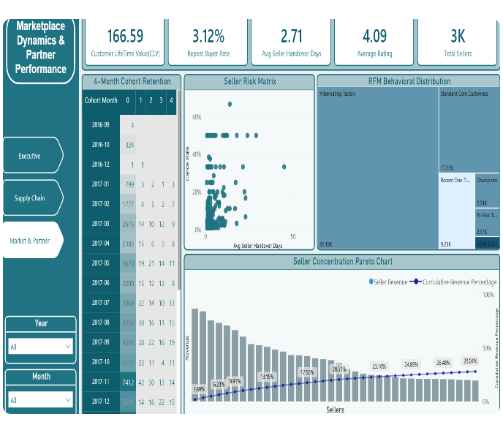
Partner Risk & Customer Retention Dynamics
Tracking the 3.12% repeat buyer bottleneck, 4-month cohort decay, and merchant compliance
R$ 166.59
3.12%
CUSTOMER LIFETIME VAL
REPEAT BUYER RATE
4.09 / 5
3,000
AVG REVIEW RATING
ACTIVE SELLERS
Severe Cohort Decay
In a cohort of 2,676 first-time buyers, only 14 return in Month 1 and 9 in Month 4. Over 96% of buyers churn after a single purchase, turning Olist into an acquisition-dependent gateway.
Seller Risk & RFM Tiers
Merchants averaging 10–20+ days handover delay suffer 40–60% cancellation rates. RFM isolates 66.18K Hibernating Testers vs 2.91K Champions to focus retention capital.
Slide 6 of 8

Slide 7


Predictive ML: Freight Pricing Engine
Multilateral feature engineering, Haversine geospatial distance, and benchmarked regressors
Feature Engineering & Preprocessing
Model Benchmarks & Selection
Extracted and joined 6 core attributes across customer, seller, product, and geolocation relational tables:
Benchmarked multiple regression architectures using 5-fold cross-validation on target freight charges:
Algorithm Evaluated | R² Score | Performance Remarks
Linear Regression (Baseline) | 0.54 | Underfits complex interstate pricing steps
Random Forest (RF) | 0.72 | Strong non-linear capture across volume tiers
Gradient Boosting (GB) | 0.72 | Robust ensemble boosting over spatial pairs
XGBoost Regressor (XGB) | 0.73 | Selected • Best predictive precision
▪
Haversine Distance (distance_km): Calculated spherical geodesic transit distance in kilometers between seller and customer lat/long coordinates.
▪
Product Volume (volume_cm3): Derived 3D packaging space
(Length * Height * Width) in cubic centimeters.
▪
Scikit-Learn Pipeline: Categorical state pair variables transformed with One-Hot Encoding; numerical distributions normalized with RobustScaler to neutralize heavy-tailed outliers.
Gradient-boosted decision trees explain 73% of freight variance, capturing physical volumetric density and geographic transit distance.
Slide 7 of 8

Slide 8





Deployment & Strategic Management Roadmap
Operationalizing live predictive analytics and delivering data-backed supply chain directives
Streamlit Application Modules
Three Strategic Directives
Deployed an interactive, multi-module web interface for cross-functional operational stakeholders:
Enforce 24-Hour Seller Handover SLAs: Tackling the 2.71-day merchant packaging delay eliminates the primary root cause pushing deliveries past promised SLA deadlines.
▪
Module 1 — Schema Explorer: Audit relational tables, inspect data types, and run ad-hoc SQL validation queries.
▪
Module 2 — Analytics Hub: Interactive Plotly visualizations for RFM clusters, ABC Pareto curves, and cohort retention.
Automate RFM Replenishment Loops: Target the 2.91K Champions and 17.69K Core buyers in high-frequency verticals (Health & Beauty, Bed & Bath) to lift the 3.12% repeat rate baseline.
▪
Module 3 — Live Freight Estimator: Real-time checkout quoter taking parcel dimensions, weight, price, and route states to output instant shipping fees.
Embed Live Freight Quoting at Checkout: Deploy the XGBoost predictive model directly into checkout pages to eliminate shipping price opacity and prevent cart abandonment.
Slide 8 of 8

